Slide 1
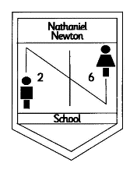
Welcome to Reception

Slide 2

Independence
We are thrilled with how well the children have settled
Thank you for your support helping your child to come into school by themselves
Please continue to encourage your child to dress and undress independently, put on their own coats, go to the toilet etc.

Slide 3







Our Topics
Autumn Term
Once upon a rhyme
Let’s Celebrate!
Spring Term
Space
The Smartest Gruffalo on the Broom
Summer Term
Secret Garden
Oh, I do like to be beside the sea
Trip in Spring Term

Slide 4
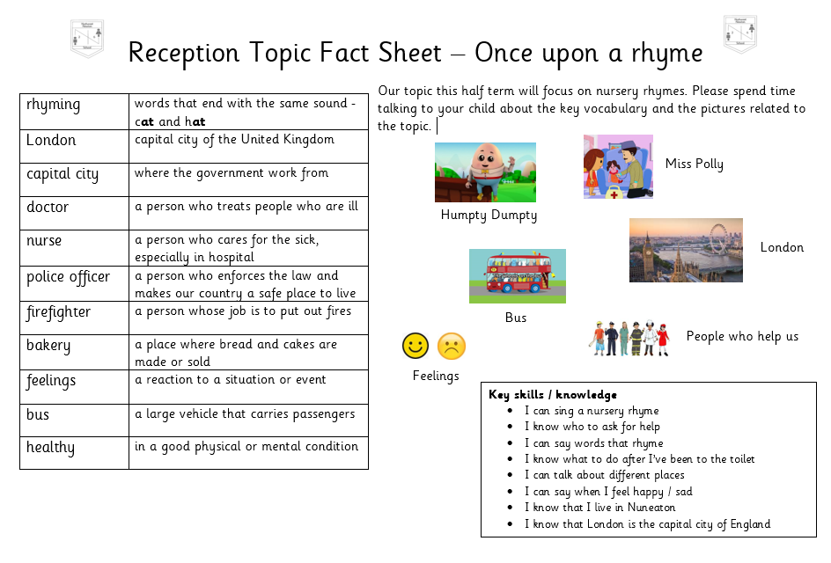

Slide 5

Rewards
“Learning together to be the best we can”
Be kind, be fair, be safe – our school manners
Star book – stars are given for trying hard, following rules etc. Sticker and prizes from Mrs Forshew
Star of the week– every child will have a turn to be Star of the week. They get to wear a special badge, will be given classroom jobs etc.
Pupil of the week – a child in each class will be chosen for good work. You will be invited to our congratulations assembly on a Friday morning to see your child receive their certificate

Slide 6

Library
Your child goes to the school library every week They will bring home a book for you to share together
Hedgehogs – Wednesday
Dragonflies / Bumblebees – Friday
PE
We will be starting PE once the children are settled (after October half term)
They are to come to school in their PE kit – white t-shirt, school cardigan or jumper, black tracksuit bottoms / leggings and trainers.
Bumblebees – Monday
Dragonflies – Wednesday
Hedgehogs – Thursday

Slide 7
Homework
Homework is sent out at the start of each half term. Activities are for you and your child to do together
A star will be given for every piece of homework returned
Homework can be sent into school or uploaded onto Tapestry

Slide 8
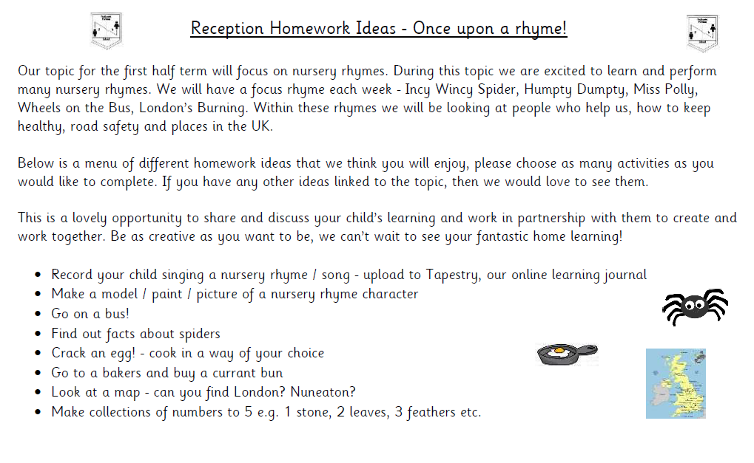

Slide 9

Tapestry
We use Tapestry to share activities that your child has been doing in school.
Please add any photographs from home of your child doing activities that we may not see or know about
Please make sure you have given us consent for your child to use Tapestry

Slide 10

Reading
Our school has chosen
Little Wandle Letters and Sounds Revised as our systematic, synthetic phonics (SSP) programme to teach early reading and spelling.

Slide 11
How we teach reading
A new sound is taught every day
Autumn Term - Phase 2 sounds – single sounds, sh, ch, th, qu, nk, ng
Spring Term - Phase 3 – ai, ee, igh, ow, oo, oo, ar, or, ur, er, air, ear, oa, oi
Oral blending
Blending sounds to read words
Tricky words – words that we cannot sound out e.g. the, like
Writing sounds – use a rhyme to help
Spelling – using our segmenting fingers (say the word, segment the sounds, write it down)

Slide 12
Terminology
Phoneme
Split vowel digraph
Grapheme
Blend
Digraph
Segment
Trigraph

Slide 13
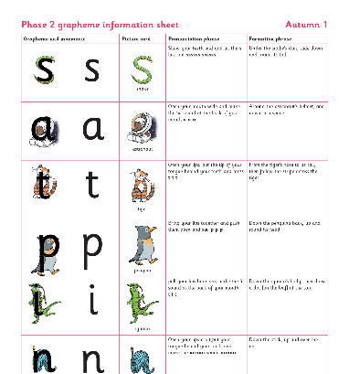
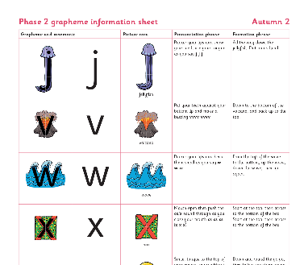
Teaching order

Slide 14

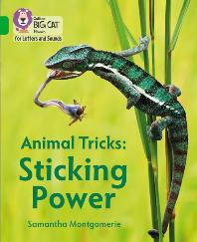
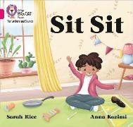
How do we teach reading in books?
Reading practice sessions are:
timetabled three times a week
taught by a trained teacher/teaching assistant
taught in small groups

Slide 15
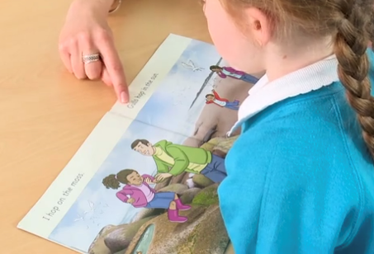
Reading a book at the right level
This means that your child should:
Know all the sounds and tricky words in their phonics book well
Read many of the words by silent blending (in their head) – their reading will be automatic
Only need to stop and sound out about 5% of the words by the time they bring the book home – but they should be able to do this on their own

Slide 16
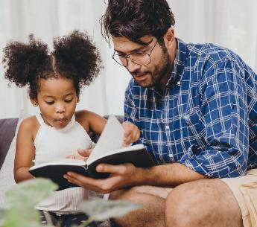
The most important thing you can do is read with your child
Reading a book and chatting had a positive impact a year later on children’s ability to…
understand words and sentences
use a wide range of vocabulary
develop listening comprehension skills
The amount of books children were exposed to by age 6 was a positive predictor of their reading ability two years later.
Parental involvement in the development of children’s reading skills: A five-year longitudinal study (2002) Senechal, M. and Lefvre, J

Slide 17
Sounds
Every week your child will bring home the sounds that we have learnt in school
Practice reading and writing the sounds using the rhymes to help
Importance of pronouncing the sounds correctly see information for parents - https://www.littlewandlelettersandsounds.org.uk/resources/for-parents/
Make words using the sounds for your child to read
Oral blending games – can you get your c-oa-t

Slide 18



Books going home

Slide 19
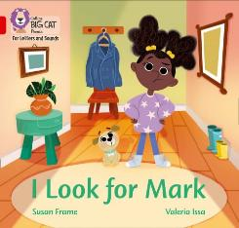

Listening to your child read their phonics book
Your child should be able to read their book without your help.
If they can’t read a word read it to them.
Talk about the book and celebrate their success

Slide 20

Read to your child – library book
The shared book is for YOU to read:
Make the story sound as exciting as you can by changing your voice.
Talk with your child as much as you can:
  Introduce new and exciting language
  Encourage your child to use new vocabulary
  Make up sentences together
  Find different words to use
  Describe things you see

Slide 21
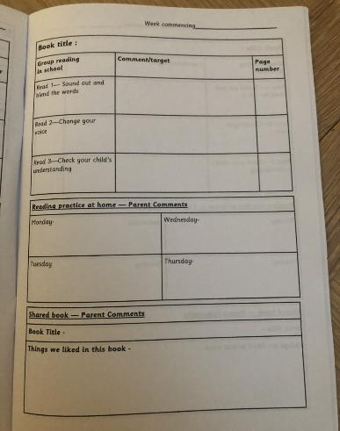
Reading Diary
This section of the reading diary will be completed by school staff.
This section of the reading diary is to be completed by you at home.

Slide 22
Reading Raffle
Each time a child reads at home, and gets their home reading diary signed they will receive a raffle ticket to go in the class raffle box
At the end of each half term, the raffle will be drawn and a golden token will be awarded to the winner
The winner can then spend their token in our ‘Nathaniel Newton Book Vending Machine’
The more the children read, the more raffle tickets they will get, therefore the more chance they have of winning the half termly class prize

Slide 23
50 Reads
Each year group has a list of 50 books for you to try and read during your time in that year group
In the back of the reading diary there is a checklist of the books. Tick them off as you read them. Once you have read enough, you will earn a reward:
Number of Books | Reward
2 | A certificate
5 | Bookmark
10 | Pencil
20 | Reading Star Badge
30 | Golden Coin for the vending machine
40 | Golden Coin for the vending machine
50 | £5 Scholastic Book Fair Voucher

Slide 24

Thank you for your continued support
Any questions?

Slide 25

Maths
We focus on a deep and secure understanding of numbers to 10
Counting accurately, recognising, ordering, comparing and using the numbers within 10
Noticing patterns
Subitising – being able to recognise amounts to 6 without counting
Recalling ways to make numbers within 10
5 and 5 makes 10, 5 and 1 makes 6 etc

Slide 26
Maths – ways to help at home
Practise counting forwards and back from different numbers
Counting accurately. Encourage your child to put objects in a line, move them to a different place. Give one number name to each object. If counting objects that can’t be moved, draw a line through them to show they have been counted
Look for numbers when out and about
Order numbers to 10. Mix numbers up, take some away. Can your child see what has happened?
Practical addition and subtraction. If you have 3 sweets and you get 2 more, how many altogether?
To help develop fluency – quick fire questions
What is 1 more than 6?
What is 1 less than 10?
Ways to make 10 (6+? 8 +?)

Slide 27

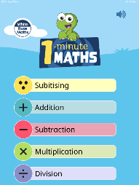
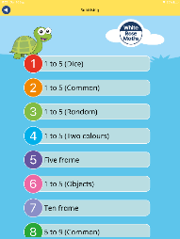
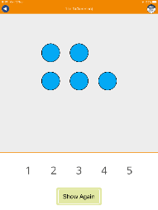
Useful games / websites
CBeebies – Numberblocks
White Rose Maths App – 1 minute maths
Subitising

Slide 28
Communication
Newsletter at the end of every half term
Website - www.nathanielnewton.co.uk
Facebook page
Tapestry
Arbor (download app and log in) - any messages will be emailed to you. Details can also be updated here e.g. adding people who will collect your child
If your child has an accident – sent an email, if it is more serious, we will make a telephone call
Curriculum letter at the start of each half term
Ways to help videos (website or Tapestry)
Please come and ask if you are unsure!

